Slide 1
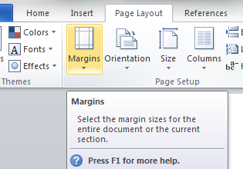
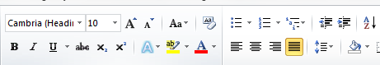

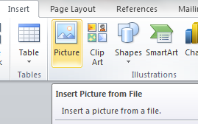
Chapter 17: Document Production (Word)
Task 5
Using a suitable software package, load the file DRAFT.RTF Save this document with a new file name. Set the page size to A4. Set the page orientation to landscape. Set the page margins to 2 centimetres. Place in the header: • Your name and candidate number left aligned • Your Centre number right aligned. Place in the footer: • Today’s date left aligned • The automated file name and file path right aligned. Insert this title at the start of the document and apply style: Company Information Release Insert the subtitle below the title and apply style: Details presented by: followed by your name. Format the document after the subtitle into two equally spaced columns, with a 1 centimetre gap. Format all the text that follows to body text style.
House Style Specification Sheet Title: Sans Serif, Underlined, 24pt, Right Aligned Subtitle: Sans Serif, Italic, 18pt, Left aligned Subheading: Sans Serif, Bold, Italic, 14, Centre Aligned and one clear line space after each subheading. Body Text: Serif, Black, Single Line Spacing , 14pt and Justified. One clear line space after each paragraph.

Slide 2
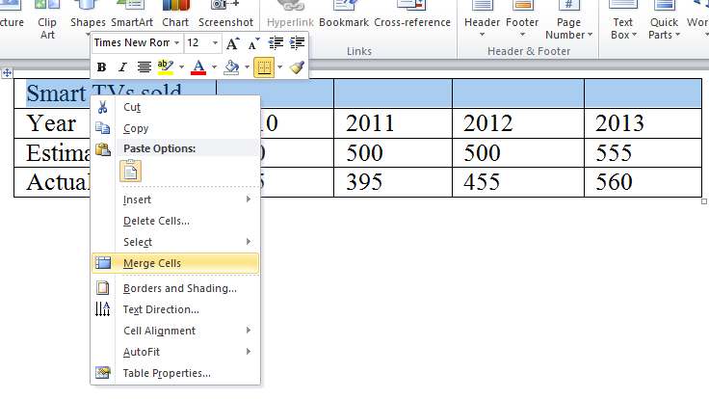
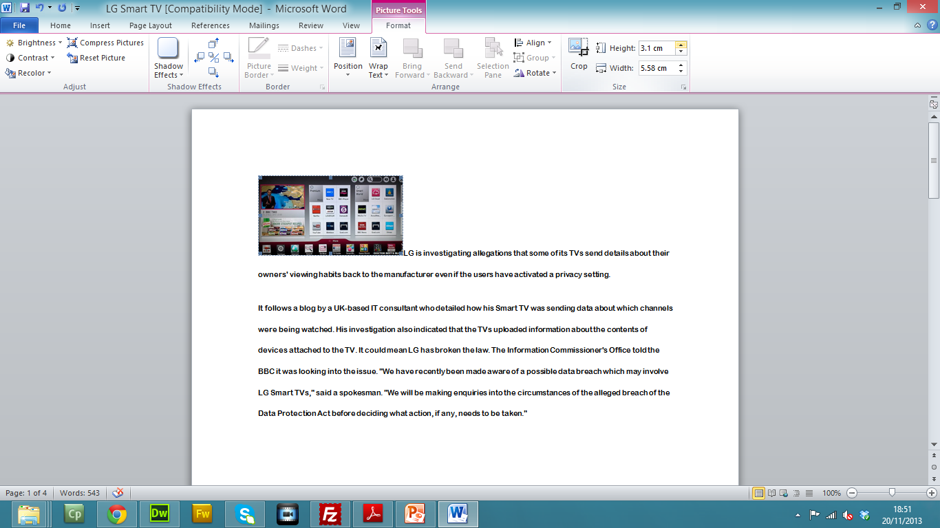
Chapter 17: Document Production (Word)
Task 5
12. Identify the list: Preparation of Economic… to …Operator Training Set this list as bulleted text using square shaped bullets. Make sure there is no blank line spacing between the items in the list. 13. Identify the 3 subheadings and apply style. 14. Use the data from the file INCOME.CSV to create a pie chart to show the Commission for the years 2010 to 2014. Display the Commission values as segment labels on the chart. Display a legend to show the years. Insert the text: Income from projects as the chart title. Pull out the segment with the highest commission. 15. At the end of the document, after the words …from on-going work): add the text: The chart shows that the best year was and add the year you have chosen from the chart. 16. Insert the chart at the end of the document. Make sure that the chart: Fits within the page and column margins Is not distorted.

Slide 3
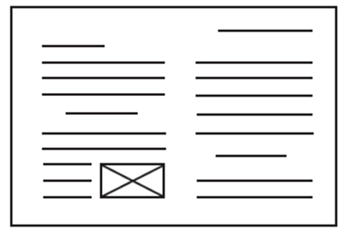
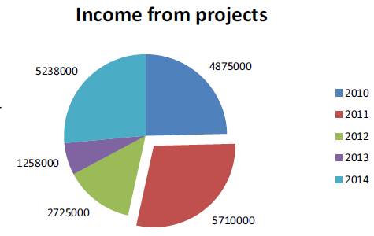
Chapter 17: Document Production (Word)
Task 5
17. Place the image REFINERY.JPG in the document at the top of the third paragraph which begins: Projects include municipal water… 18. Re-size the image to fill half the column width and maintain the aspect ratio. 19. Align the image with the right of the column and the top of the text. 20. Make sure the text wraps round the image. 21. Spell-check the document and correct any errors. 22. Proof-read the document, placing column or page breaks, if necessary, to make sure that: Spacing is as specified and consistent Lists do not overlap two columns or pages There are no widows or orphans There are no blank pages.

